Slide 1


Flip Flop Word Game
Industrial Oriented Mini Project : Final Review
Presented by:
Akhila Thammenenwar
Anjali Talloju
Pranathi Sai Kalavagunta
Neha Goute
Internal Guide:
Mrs. Ch. Hyma

Slide 2
Abstract
A memory-based word game designed for Android using Python and Flet.
Players view, memorize, and reconstruct scrambled words.
Enhances cognitive skills like memory and recall.

Slide 3
Contents
Introduction
Existing System
Disadvantages
Proposed System
Advantages
Architecture
Algorithm
Modules
Testing
Demo & Screenshots
Conclusion & Future Enhancements

Slide 4
Introduction
The Flip-Flop Word Game is an interactive Android game developed using Python and the Flet framework.
It challenges users to memorize and reconstruct scrambled words, helping improve:
- Short-term memory
- Attention span
- Pattern recognition
Built using Python and Flet framework for Android compatibility.

Slide 5
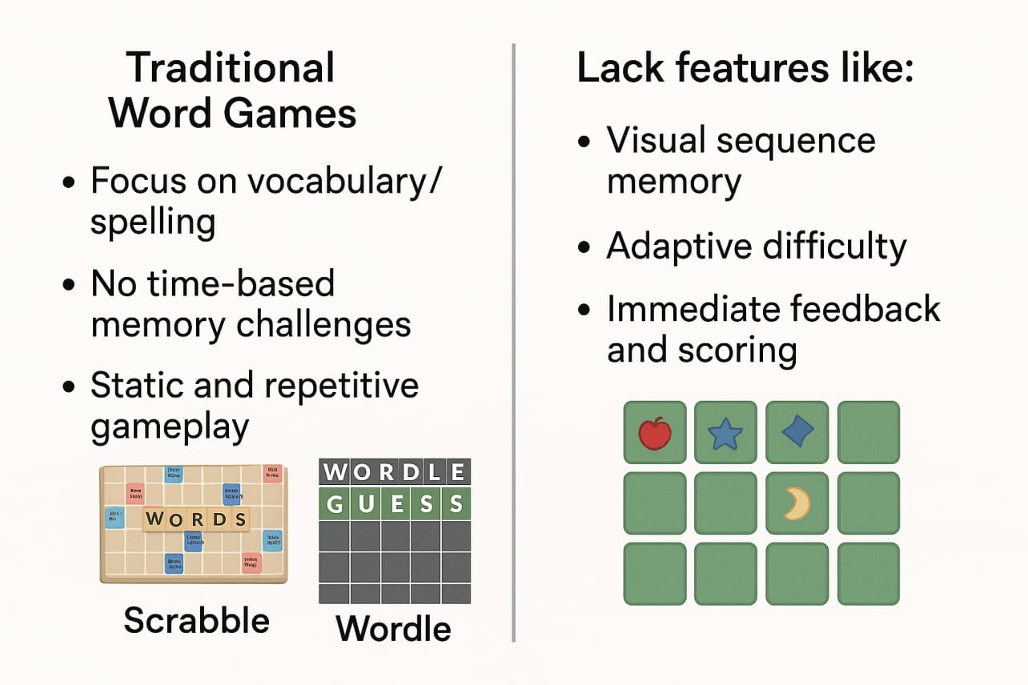
Existing System

Slide 6
Disadvantages of Existing System
- Language-focused, not memory-oriented
- No visual memory challenge
- Static difficulty
- Passive gameplay
- Limited cognitive challenge

Slide 7
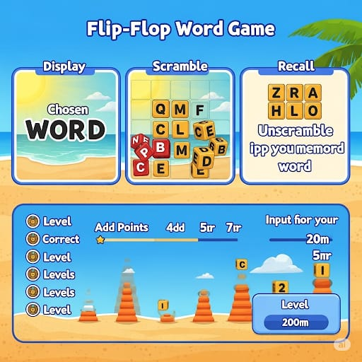
Proposed System
Flip-Flop Word Game with 3 Phases:
- Display: Word shown
- Scramble: Letters shuffled
- Recall: User reconstructs original word
Includes scoring and levels.

Slide 8
Advantages of Proposed System
- Enhances short-term memory
- Engaging & time-based gameplay
- Cross-platform UI
- Offline use
- Educational and fun

Slide 9
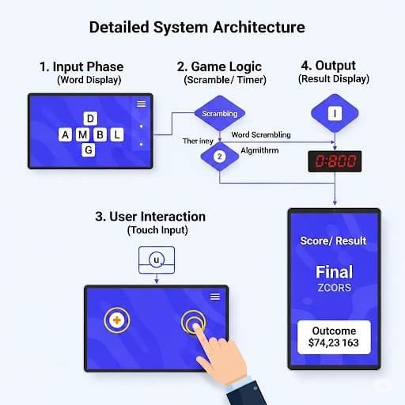
Architecture
System Architecture:
1. Input Phase (Word display)
2. Game Logic (Scramble/Timer)
3. User Interaction (Touch Input)
4. Output (Score/Result Display)

Slide 10
Algorithm Used
1. Random word selection from dataset
2. Shuffle letters with block numbers
3. Capture user sequence input
4. Compare with correct sequence
5. Update score and display result

Slide 11
Modules and Explanation
Game State Management
This module defines and controls the current phase of the game using an enumerated state machine (Game State). It includes:
SHOWING_ORIGINAL: The word is shown for memorization.
SHOWING_SCRAMBLED: The word is scrambled and shown with numbered blocks.
WAITING_FOR_ANSWER: The player enters their answer.
SHOWING_RESULT: The game shows whether the answer was correct or wrong.
- UI with Flet
The Flet framework is used to create the user interface entirely in Python, eliminating the need for HTML or Android SDK code.
Provides mobile-friendly UI components (buttons, text fields, containers).
Manages layouts using ft.Column, ft.Row, and ft.Container.
Customizable styling (colors, padding, shapes).
Responsive design for various screen sizes and game states.

Slide 12
.
.
- Word Scrambling-
This module handles the logic to:
Randomly shuffle the letters of a selected word using random.shuffle().
Assign numbered blocks to each scrambled letter.
Store the mapping between scrambled letters and their original positions.
Generate the correct answer sequence for evaluation.
- Timer & Threading
To maintain real-time interaction, this module:
Runs a countdown timer for each phase using threading.Thread.
Uses time.sleep(1) to decrement time per second.
Updates the timer display without freezing the UI.
Automatically transitions between game states when time runs out
- Input Handling & Feedback
Handles user interactions and provides immediate feedback:
Accepts numeric input (block positions) via a TextField.
Validates the answer against the correct sequence.
Updates score based on accuracy (+20 for correct, -10 for wrong).
Displays results ("Correct!" or "Wrong!") and triggers the next round

Slide 13
Testing
- Manual Testing on Android
- Functional validation
- UI responsiveness
- Edge case handling
- Score accuracy and transitions

Slide 14
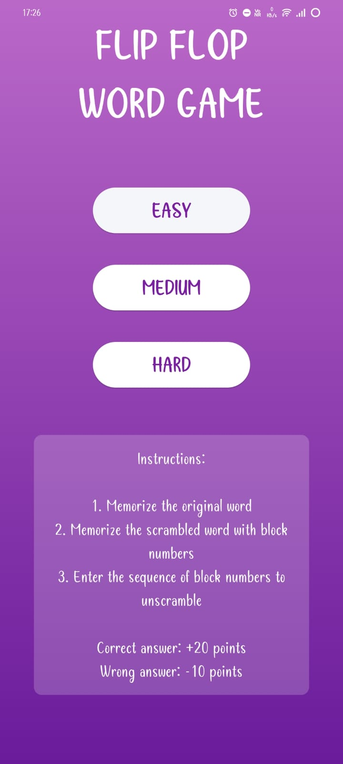
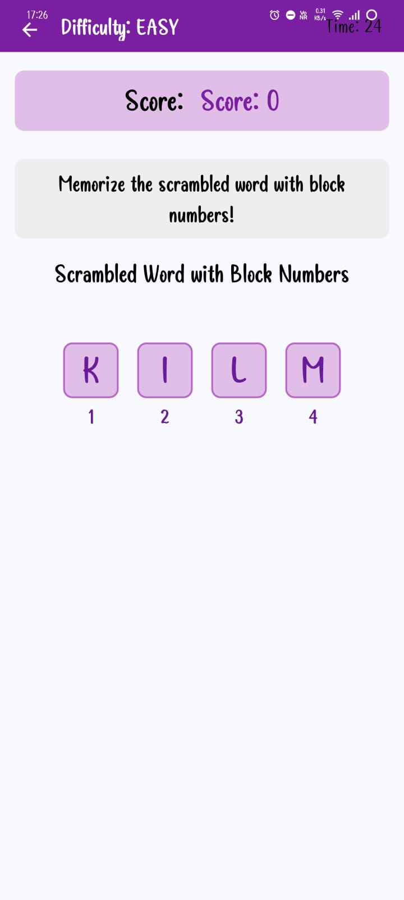
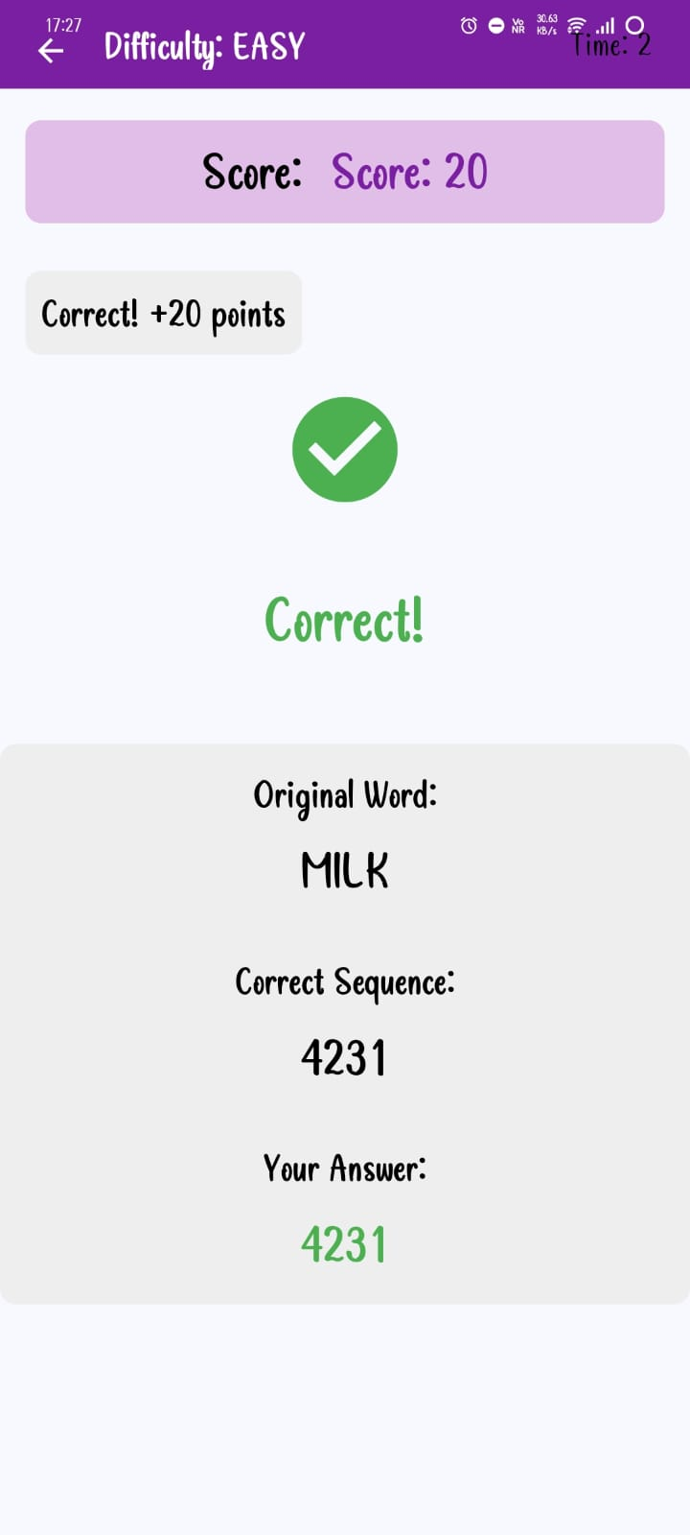
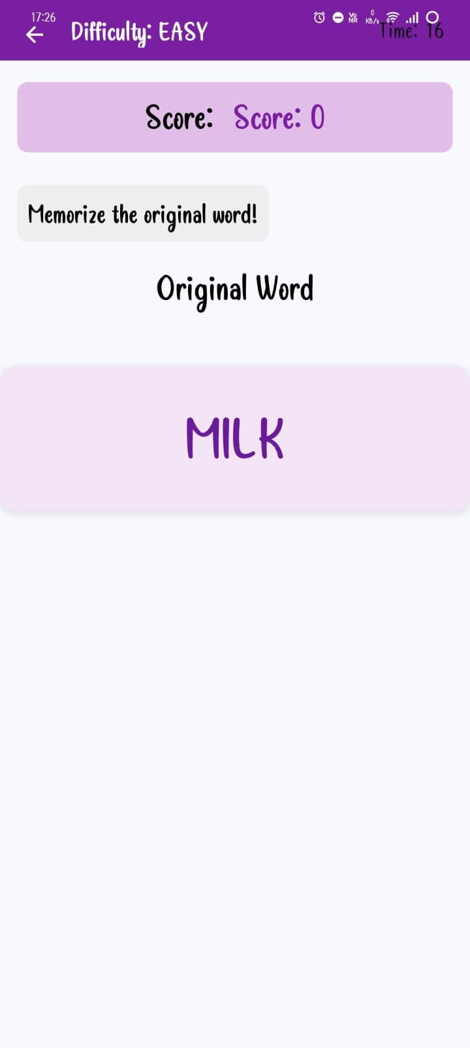
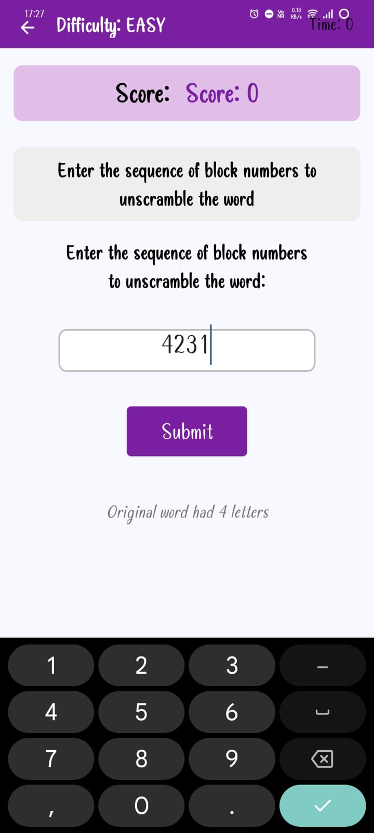
Demo & Screenshots

Slide 15
Conclusion & Future Enhancements
Conclusion:
Developed using Python and Flet, the Flip-Flop Word Game demonstrates how modern, cross-platform tools can be used to create effective educational applications with minimal overhead.
The choice of Python ensures readability, rapid development, and ease of maintenance. Python's rich standard library and third-party modules allow efficient implementation of game logic, word handling, timers, and threading.
The Flet framework acts as a bridge between Python and Flutter UI, enabling the creation of native-feel mobile applications without requiring Android/Java code. This significantly reduced the development complexity while maintaining a responsive and interactive user interface.
The game’s structure, which includes clear state management (memorize → scramble → recall), promotes cognitive enhancement in a fun and engaging format.
Through interactive gameplay, real-time feedback, and memory challenges, this project successfully blends entertainment with education.

Slide 16
Future Enhancements:
Multiplayer Mode: Allow players to compete against each other in real-time or turn-based challenges.
User Profiles: Enable personalized progress tracking, preferences, and saved scores.
Achievements System: Reward users with badges or milestones to increase engagement and motivation.
iOS Support: Expand the app’s reach by making it available on Apple devices using Flet’s cross-platform capabilities.

